Slide 1
Python Review
Il-Chul Moon Dept. of Industrial and Systems Engineering KAIST
icmoon@kaist.ac.kr
Notes:
This time, we’ll review of the programming language called Python.
We will learn about how to structure and analyze various data throughout this lecture.
This is the basic precondition that will enable us to use programming languages.
So let’s find out how to use the Python language.

Slide 2
Weekly Objectives
This week, we review Python that will be used for a programming language for this course.
Objectives are
Setting up the Python development environment
Executing “Hello world” program
Memorizing basic grammar of Python
Understanding Python programming structure
Understanding the reference of Python variables
Understanding control and loop statements
Understanding function calls and class declarations
Understanding list, tuple, and dictionary in Python
Executing a sample GUI program
Notes:
The following is what you will learn in this week’s lecture.
It would be great if you could fully prepare to the point that you can actually use Python when we finish this week’s lecture.
Basically, there is a close relationship between what’s called programming, data structure, algorithm or data structure, and analysis.
More precisely, you could say they are related, but work on different layers.

Slide 3
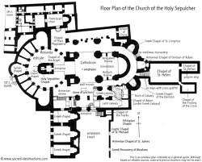


Programming and DS&A
What is programming to data structure and algorithm?
Programming is an implementation tool
Conceptual thinking and design
Where to put the restroom
How to find the restroom
Practical design and implementation
What to use for designing the restroom
How to move to the restroom
Both are important
Should pursue good design and good implementation
Good design and bad implementation?
Bad design and good implementation?
Notes:
We will primarily deal with the question of what is programming. We’ll also look into the significance that programing has on data structure and algorithm.
In essence, programming is a tool that we can implement.
If we were to cite an example, it would be like this.
Here is an architect. The architect is also an engineer.
An architect is earnestly trying to build a house now.
What he is holding is a blueprint.
There are blueprints here and there that contain ideas of how a house should be used by its occupants.
The blueprint is well structured, which means that it is designed to assist the various behavioral patterns and tasks of the supposed residents of the house.
It is structured and reflects other considerations, such as how people operate inside the house, live their daily lives, or work.
The design is drawn and the structure is determined in consideration of such factors.
This planning does not end with a blueprint.
After drawing a blueprint, the architect will build a house.
If he is to build a house, what does he need to do next?
Next, he needs tools and equipment to construct the house.
Although it is possible to build a house with a shovel or hammer, it would be a daunting task. He would need heavy machinery to help him realize the plans in his blueprint.
This kind of engineering needs this type of design. Let’s call it implementation.
Planning and design also requires is implementation.
To be able to carry out implementation, we will employ something called programing. To realize design, we basically adopt a standard design format called UML to draw a design.
In this regard, we have to take account of the fact that design is fundamentally a data structure and algorithm.
In this example, we should consider where to place a restroom and how to help people find where the restroom is.
These considerations should be designed and implemented realistically.
Both of these elements are equally quintessential.
Many tend to think that all they need to do is to do is write their programming code well. In fact, however, those working in the industry would agree that programming skill alone is not enough as they progress from a novice technician to a middle, advanced, and super-advanced engineer.
The same holds true for students.
Many Korean university students are excellent in programming.
If you are to set yourself apart from the rest, you have to ponder over how to design good software as an engineer.
It is about how to design static structures and how to take consideration of active operations in static structure in the design.
That’s the way to look at the relationship among data structure, algorithm, programming.
Of course, no one person can excel in all of those aspects.
In this regard, the aim of this lecture is to assist you to make a good design. I plan to carry out the minimum implementation to realize it.
Why don’t we look at a combination of a bad design and great implementation? Why don’t we compare them?
Something like this will produce divergent opinions.
I personally believe that the combination of a good design and a bad implementation is bearable.
However, no matter how great the implementation is, an unsatisfactory design will cripple its value.
It will even hamper the efforts of those who engaged in implementation.
That’s why the role of the engineer who is responsible for design is so important.

Slide 4

Python
Python
Introduced by Guido van Rossum in 1991
Interpreter
Object-oriented
Dynamic type of variables
Increasing usage by industry and academia
Unique code structure
Mandatory indentation…
Fast development speed, slow execution speed
Specialty in data analyses
Various numerical and statistical libraries : NumPy and SciPy
Base language for TensorFlow and others
Notes:
Previously, we had a figure here, saying that we need to utilize various tools.
What we’re going to employ among our various tools is the one called Python, or programing language.
Python is a language that was launched in 1991.
It falls into the category of an interpreter language.
On the very opposite end of the interpreter language, there is a compiler language.
A complier language optimizes a language prior to the execution of a software program
On the other hand, an interpreter language does not put emphasis on optimization. Rather, it is a language geared towards readiness for execution and the easy and fast creation of a program.
As a result, an interpreter language tends to be less bounded than a compiler language.
That’s the reason I choose an interpreter language. It’s suitable for teaching design objectives, such as data structure and algorithm.
Secondly, it has an object-oriented programming concept.
Many of today’s implementations are already based on object-oriented programming.
Therefore, it’s not really brand new.
In particular, we will learn how to structure data for the design of some objects or instances of some objects when we are engaged in designs.
In this case, as an object plays a significant role, it is necessary to use an object-oriented language.
It is also characterized by its tendency to support dynamic typing.
Many complier languages do not support dynamic typing. These languages declare variables as well as their types in advance.
However, many interpreter languages support the use types that can be changed for different occasions.
The Python language was selected to ensure easy implementation.
There is also a more realistic reason for it.
It is increasingly used in the industries and academia.
Many graduates will continue their studies further or get jobs.
Regardless of which paths these graduates take, it is likely that they will use Python.
Although its code structure is very unique, this uniqueness is generated from
Its features that force it to maintain a good structure.
For instance, there is a thing called “mandatory indentation”, which we will go over in detail.
I like the way Python clearly dictates the rules for the code: this is the way you write code.
Some might think that the more rules you have, the more difficult it is to create a program.
But once you understand these rules, it would be easier to follow the rules than freely write code.
Thus, it is advisable to select a language with good rules.
Python is a language that has features like these.
Python also offers fast development speed and slow execution speed
It can be said that Python can showcase the characteristics of complier languages.
Basically, the purpose of our implementation is to help you to understand the concepts. We want to show you an idea that could be implemented to such a degree in terms of design without any significant language barrier. Therefore, let me do some fast development: I’ll do some programming that’s not-optimized for implementation.
Lastly, there is an issue that is growing in importance today.
I’m talking about this.
This is specialized for data analysis.
As Python has many mathematical and statistical libraries, it can be best utilized for analysis.
You’ll definitely find it very useful for learning various future-related subjects including machine learning and artificial intelligence such as TensorFlow. This language will be very helpful to you in terms of data analysis.
That’s why I chose Python.
I will take this opportunity to delve into data analysis by using the functions of Python in this lecture.

Slide 5



Programming and Execution Environment
You will need an integrative development environment (IDE)
To reduce implementation time
To reduce debugging time
To maintain consistencies between your classmates
Software
Eclipse – IDE software
PyDev – Eclipse plugin for Python programming
Python – Programming Language
PyCharm – IDE Software
Refer to the below website for the setup
http://pydev.org/manual_101_root.html
Notes:
After learning to use Python, I’ll show you how to apply Python to develop a nice program.
To carry out “take”, we should set up a programming and execution environment. When Python is installed, you won’t find a menu like you would see in a Windows program.
You’ve got to run a program by making a text file.
To alleviate the hard work and complication, it is common to use an IDE, or Integrated Development Environment.
This IDE makes it easier for us to use Python by using the upper level of the language.
This tool has a function to connect Python with Eclipse or Pycharm. You can write code, using something like a text editor, before pressing specific buttons, and it will allow you to view the result of your executed Python code.
These are called IDEs
Using IDEs, you can shorten the implementation time and, of course, time spent in debugging.
It’s my basic opinion that you can discuss and share code. Of course, you would not share code for class assignments.
I think, however, that it’s not a problem to share code when you practice in class. Thus, it is necessary to use the same IDE.
Then we can apply Python to Eclipse with pydev and utilize Python in an environment called Pycharm.
If you are students or members of educational institutions, you can get easy and free access to Pycharm.
I will consider Pycharm as our basic implementation tool in this class.
Aside from that, there is a good IDE called Eclipse.
Using Eclipse, we can conduct Python development. There are other types of software such as Pycharm.
So, it is possible to use other IDEs.
We need a process in which you can install software through various webpages and follow what’s in a manual.

Slide 6
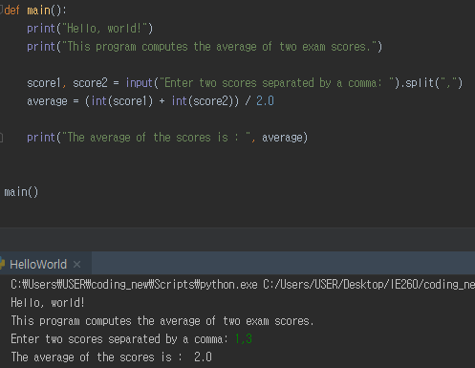
Hello World in Python
Your first Python program in this class
Procedure-oriented program
main() is a function
Largely in two parts,
Definition part
Execution part
Notes:
Now let’s suppose that we have installed Python and we already have a program to run.
It will be implemented with an IDE, such as pydev of Pycharm or Eclipse. Although the IDE may be different, the program itself is the same.
So, I will explain it to you by focusing on the source code of a program.
When you first learn about a programming, what’s the first thing you usually learn?
Let’s print out “Hello world”.
This will be the first Python program for you.
When you code, you can either create an object-oriented program or a procedure-oriented program.
Python can do both. For this first example, let’s make a procedure-oriented program.
A procedure-oriented program is primarily based on function.
What is the opposite form of that?
This would be the concept of “object-oriented”, and this is handled by devising something called a class.
Here, we are talking about a procedure-oriented program, it is based on function.
Its source code would be like this.
Basically, here we state a function with a “definition”.
These will be the keywords for function declarations.
It is the name of the main function found here.
These brackets will contain variables. Just like mathematical functions, these values will be input and output.
Here, there is no definition for input variables.
And the colon at the back works on declaring that it is a single block.
These specific sections here will be placed in front of the blank to make a declaration.
If we look at this whitespace in front, you will notice that it is a significant gap.
This is called an indentation.
Python uses indentations to designate blocks.
You will see that the upper part up to here becomes Block 1 and the lower part is Block 2.
Where does Block 1 belong to?
You see, it falls under the part related to the function declarations where this colon is designated.
What would happen inside the function?
You can make an instruction, “Hello world” with “print”, Here, these are instructions for a program that computes the average of two exam scores”.
Then it also employs another function called input to be able to receive score1 and score2 from outside.
It gets the sum for score1 and score2, and then gets the average value by dividing the result by 2.0 and prints out the average.
If you run a program, for instance, if you enter values such as 1 and 3, you will get 2.0.
This covers how the function is declared or defined.
The function called Main is defined to conduct such a task.
Making a definition and implementing it are different tasks.
When you actually implement the defined functions, for instance, if you look at the upper part of the IDE such as Pycharm, you will find a play button.
If you press the button, it would not run well.
This means that Python will only memorize the fact that there is such a function. It doesn’t do any further operations.
So, here comes the function, main0. It is well defined for implementation by calling it to run as seen here.
When there is no second block, it will only have a definition, but there’ll be no implementation.
I’ve printed out “Hello world” with Python.

Slide 7
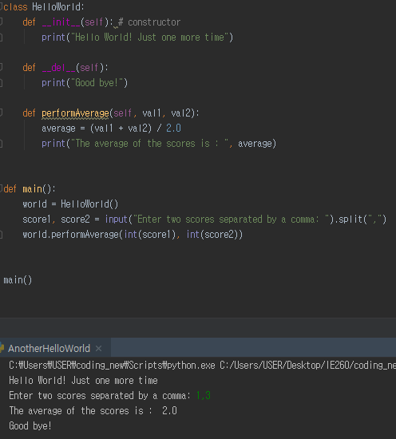
Python Program Structure - Another Hello World
Your second Python program in this class
Object-oriented program
HelloWorld is an object
__init__, __del__, and performAverage are methods
Largely in two parts
Definition part
Execution part
Notes:
This time, I will print out “Hello world” in a different form.
This is our second Python. Let’s make it with classes as an object-oriented program.
The class here declares the object.
The indentation shows that it is a single block from here to here in a class.
Inside a class, there is something called def.
This def is identical with the one in function, but it differs since it uses the concept of “self”.
Self means itself.
When it is declared in the form of a member function or method within the class, self will also follow.
When the class instructs to “execute something” or “fetch some information” within the function, the variable, self, is allowed access.
Here, the function goes up to this point. This function goes up to here, and that function ends here.
You can recognize different functions with indentations.
To use a class, you need a keyword to declare a class.
Classes have names.
You also need a colon, indicating the next area is a block.
The ways to declare and print functions are illustrated in the previous slide.
This __init__, __del__ stands out as it has underscores.
Let’s find out what that means.
With instantiation, classes turn into instances. init is executed during the process, and when instance is removed, del is executed.
We will go into detail on this process later.
The role of classes is to declare the names of the pre-defined functions that include two underscores. This will enable them to be automatically called at the appropriate time.
Here, the class is only declared and should be able to use the class as before.
Here is a program I’ve done that turned the use of class into a function.
If you see here, you will find HelloWorld().
This part instructs to create another class.
When another class is generated, it will create something called “world”. In this regard, you can see the class, “HelloWorld”, as a type of framework for making something else. Let’s call what is made out of that framework or template an “instance”.
Thus, “world” is a variable that contains instances while HelloWorld() can be viewed as an instance template to produce such an instance.
The function input permits it to receive two values from outside.
We can get two variables with Variable 1 and Variable 2.
Implement the performAverage function contained in “world”, or a single instance created by the above “HelloWorld”.
Unlike before, there are input variables.
score1 and score2 can be input as variables.
Now, let me pose this question.
“Where can we apply ‘self’?”
Self receives a value from “world” to deliver.
In other words, we use self to access its own instance created within the function.
As this example does not use “self”, you cannot see how it is applied. But there is a structure.
What’s in front of “(point)” has a variable. “self” is ahead, so that there are only two input variables written at the back.
Here, you see the definitions for three variables. They are designed to receive information in front of the ‘.(point)’
The process can be largely divided into two different parts.
Definition and implementation.
The “main” function is also a type of definition.
Thus, it is necessary to have something to do actual implementation.
The implementation will be carried out with main()here.

Slide 8
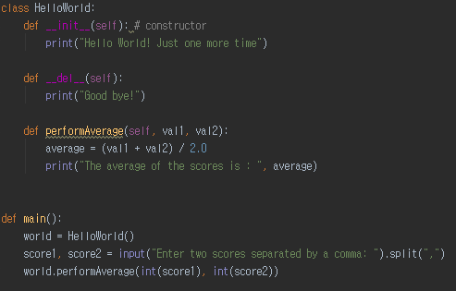
Naming and Styling
Naming : Use names clearly conveying the meaning
Use camel casing
Class name : Noun for the concept to be represented by the class
Capitalize the first letter of each word
e.g. class MyFirstClass:
Variable name : Noun for the contents to be stored
Start with lower case
e.g. numberOfStudents = 100
Acceptable, but not recommended in Python
e.g. intCount = 0;
Method name : Verb for the method action
Start with lower case
e.g. def performAverage (self,val1,val2 ):
Indentation
4 spaces per each level
Notes:
Before proceeding any further, let’s discuss the two programs we wrote before.
One topic I want to go over is naming and styling.
When you build a program on your own, it should be enough for you to understand how your program is operated.
However, when you are engaged in programming or get a job in the field after graduation, it is not possible to just freely write programs.

Slide 9
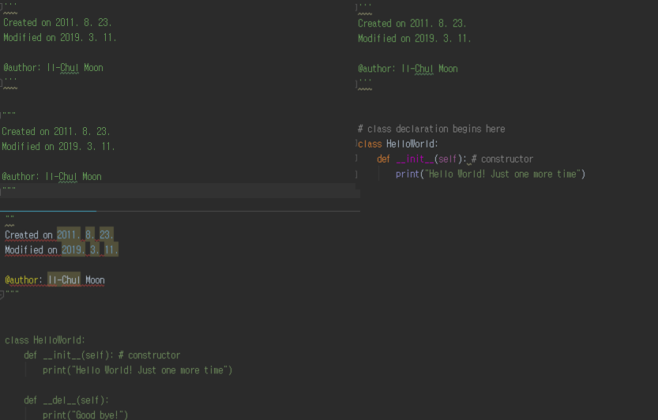
Comments
# is the beginning of single-line comments
Three of ’ is the beginning and the ending of multiline comments
Three of “ is the beginning and the ending of multiline comments
Writing comments is critical
For TA → your future boss
For your friends → your future colleagues
For yourself → yourself in future
Different types of comments
Error!
Notes:
You have to work together with others.
For example, you have to be able to explain what is the role of your program and why it was built in a particular way.
On such an occasion, you have to put some effort in defining variable names.
Would it be a good idea to name variables like val1 and val2 here?
As these functions are so simple, I made it like this. However, these are far from excellent names.
There are a range of stylings, depending on companies and labs.
Personally, I think it is compulsory to have at least some naming rules.
In essence, naming should take a form that can convey meaning well.
To do so, we need different styles for naming.
First, there is a camel casing.
Camel casing is using capital letters, followed by small letters to make certain words stand out.
This forms words, but the specific capitalization delivers some meaning.
So, W is written in a capital letter and the rest will be spelled in small letters.
As this style reminds us of the humps of a camel, it is called camel casing.
It is great to make use of camel casing. For class names, the general convention is to capitalize the first letter. This makes it easier to show that it’s a class.
For variables, it is recommended to not capitalize the first letter.
Typically, the first letter is capitalized for classes.
While classes have their first letter capitalized, variables do not have capitalized first letters.
As such, MyFirstClass is a good example of camel casing.
When you determine the names for variables, it would be great for the name to describe what type of information is in it.
As before, there are some occasions to start variable names with small letters.
Let’s say there is a variable called, numberOfStudent. It is easy to see that the variable is for storing the number of students.
Now, I’ve mentioned that Python does not declare the types of variables.
For example, Java or C declares in advance that what kinds of types val1 and val2 have.
But there is no such statement here.
Python does not declare the type of variables. Rather, the type of variables will be determined later when variables are assigned.
That means the type for a variable would not be assigned from the beginning.
In case of Java or C, the types for variables would be set to receive meaning, but this is not common for Python.
Here, names are assigned to methods or class functions.
They serve to carry out specific actions.
Therefore, they should take the form of verbs such as perform, run, and calculate.
Here, the first letter is a lower case letter.
You can cite an example like this.
You can put names to imply the calculation of an average, such as performAverage or calculateAverage.
Lastly, let’s look at indentation, which we’ve previously covered.
How to indent is determined by the rules of different labs, companies, or projects.
These rules should be abided. In our class, our indentation will be four blanks. You can also configure this gap for when you press Tab.
There are other rules that we must follow if we are to work together with others.
First, you need to annotate the code that you’ve created.
In our class, everyone should submit an assignment with full comments.
When annotating, you will declare what you have made with comments. This is called a block comment.
One of the ways to make block comments is to create a comment area by adding three small quotation marks in a row at the beginning and at the end. This will make that area irrelevant to any execution or statement.
Another way is to use three quotation marks.
If you use two quotation marks instead of three, the rest of the area will turn into a block, thereby generating an error situation.
When something like this happens, it makes us think that it’s not easy to work with computers.
There are some people who are finicky to work with.
There are some people who won’t communicate their own rules that they follow and others who meticulously follow the pre-determined documents or rules without any errors.
When working with meticulous people like that, people like me make more errors compared to them.
A computer communicates through errors: it says things like, “What is this? I don’t understand what this is? Make it again.”.
It sees minor errors as negligent, and it tries to run by accepting everything, but sometimes you really need to consider and resolve these minor parts. Dealing with little errors can be annoying, but it’s something that you have to learn.
So as you annotate a block like this, you can explain why you’ve done the design and implementation in that way. You can also annotate line by line.
Although it’s not very easy to see, you can make single-line comments.
This is not a single line comment.
You can place you a single comment like this or add a comment after the end of the line.
If you can also add the number sign (#) and write what you want, and it will become a comment.
Annotating is important to TA and a great habit that facilitates your work with your friends. It can also help you recognize what your earlier intentions were so you can better realize them later.

Slide 10
Data Types
Classification | Data type | Description and examples
Numeric Data Types | integer | signed integer, 32 bits, 2147483647
 | float | 64 bit double precision, like 1.23 or 7.8e-28
 | long integer | arbitrarily large integer, trailing L, 234187626348292917L, 7L
 | octal integer | base-8 integer, leading 0 as in 0177
 | hexadecimal integer | base-16 integer, leading 0x as in 0x9FC
 | complex | real and imaginary parts written as 3 + 4j or 1.23 - 0.0073j
String Data Types | character string | ordered collection of characters, enclosed by pairs of ', or " characters
Collection Data Types | list | ordered collection of objects, like [1,22,[321,'cow'],'horse']
 | dictionary | collection of associated key:data pairs like {'first':'alpha','last':'omega'}
 | tuples | similar to lists, like ('hen','duck',('rabbit','hare'),'dog','cat')
Notes:
So far, we’ve discussed about styling for code.
We covered code styling and how you can include information in comments. Now let’s get into the details of programming.
First of all, there is data type.
Previously, I mentioned that there is no data type. More precisely, data type is not always absent: it is assigned later.
For example, let’s say there is “numberOfStudent = 10”.
numStudent is declared, and when there is no =10, no one knows the variable’s exact type.
With the absence of an initial value, Python has no idea what kind of data it might have.
Hence, there is no type available.
However, we should know from the name of variable that it will contain some numbers. Still, we do not know whether or not it contains a decimal point.
So “= 10” is defined later and the number 10 is stored. Now, it finally has a type.
Since then, it will have a certain data type.
As we have 10 here, it will select a data type that is optimal for storing integers.
So, it will be the int type
We can then change the number to 10.0.
Now, the int type can only express integers.
As you see here, int can only store signed integers.
So how can we store the number with a decimal point like that?
Perhaps, that’s when the float type comes in.
This is a data type that can express numbers with greater precision, or in other words, decimals
Things like long integers require additional marks.
For instance, a long integer can express a large number, but it should place a character L at the end of the number to classify it as a different data type.
We can also store something called a character string.
In addition, there are arrays and collection variables, which are collections of information.
This is a collection of basic things.
Here, you can find list, dictionary, and tuple.
We will get into the ways to use them in the next slide.

Slide 11
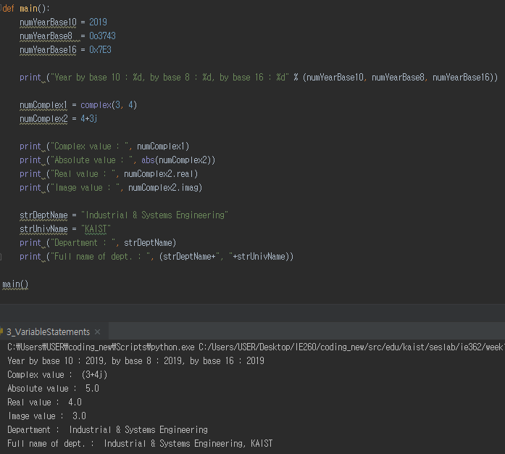
Variable Statements
Integer in decimal, octal, and hexadecimal
Complex numbers
See the naming style
See the naming style
Notes:
Now that we’ve learned about data types, let’s move on to the declaration of variables.
When you see code like this, I recommend you to check it out by coding in an actual IDE.
There is a main function declared.
This function calls and executes something called “main”.
This is what we’ve touched upon when we deal with Hello world.
Integers can be declared as decimal, octal, or hexadecimal.
Thus, it makes it possible to express the number 2019 in this way.
Then, the numbers can be printed out as such.
If you look at this, you will see %d.
%d plays the role of designating these values to be included here.
This is a sign for a line feed.
If you use the line feed sign, it will insert the value in front of it.
In math, there is the concept of complex numbers.
A complex number can be declared by “complex.”
You can state it in this way or to express a complex number by adding ‘j’.
You can print it out like this. You can also express a complex number based on the fact that it consists of a real part for real number and an img part for an imaginary number with “.(point)”.
You can conjecture that it is declared in the form of a class within Python so that it becomes an instance.
Let’s make a string.
A string can be designated with double quotation marks.
If you look here, you will see a comma (,), and it will assist with a consecutive printout.
As you see here, strings are summed up and continuously printed out with commas (,).
We’ve learned about how to express and store strings and various numbers.

Slide 12
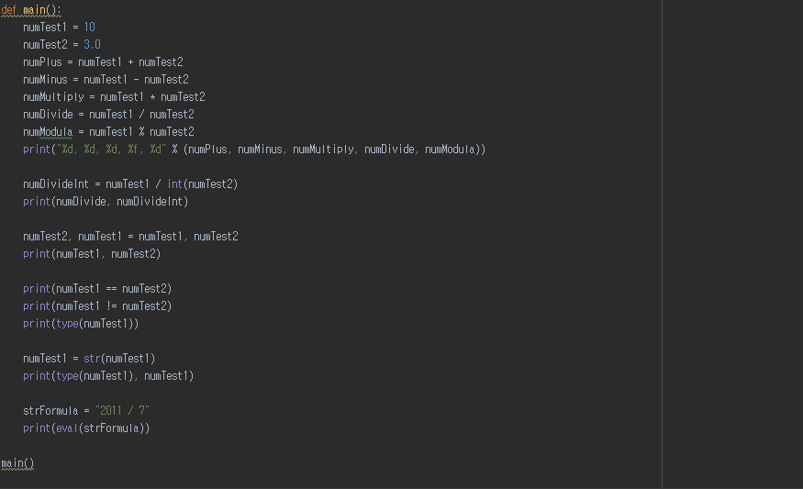
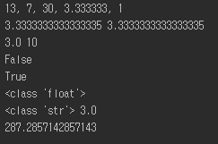
Operators
+, -, *, /
Then %?
It is the modulo operator
See the effect of type casting and how-to
int(variable name)
See the effect of type casting and how-to
int(variable name)
See the swapping statement
== is the equivalence of values
!= is the in-equivalence of values
String Formula evaluation
Notes:
Likewise, I will show you how to handle simple operators.
Operators can be understood as types of instructions for calculating numbers, just like arithmetic.
% refers to a way to make the remainder after division.
We’ve learned that %d printed here represents integers.
Here, %f indicates that a decimal point should be expressed.
%f can even express decimals.
If we apply “int”, we can see how division is carried out.
Applying “int” means that the result will be turned into an integer.
As numTest2 is 3.0, it’s being stored as a float.
If you conduct a division with this float, you will get a result with decimal places.
Here, numDivide will divide Test1, which is 10, by Test2(3.0). It will then take the form of a float with the result of 3.333.
So, when the result has decimals, it will maintain all decimal places.
Thus, it will be printed as 3.333 like this.
However, Test1 is the value of 10, whereas Test2 changes the result to 3 with “int”.
So, if you carry out division, numDivdeInt will be 3.
That’s because all the numbers featured here take the form of int.
Int always keeps the value with the larger data volume. In float, numbers after the decimal point will not be part of the result after int is used. “.333” from the data should then be discarded.
In this case, only the number 3 is expressed.
If you print such information below, it will be expressed to show different values.
As we have seen, it is possible to artificially change the types of variables.
The conversion of variable types is called type casting.
This is one way of type casting, and the other is like this.
Type casting can also be completed with strings.
When numTest1 is 10, it will be recognized as two separate characters, 1 and 0, and stored as strings.
When teaching the assignment of these variables, the most commonly used example is the swapping of variable data.
This involves the exchange of information in numTest1 and numTest2.
Exchanging information like this is called swapping. Some other languages have no concept of commas (,), so the exchange would require at least three lines. With Python, however, the swapping statement can be completed in a single line.
Lastly, if you are to compare whether or not two values are identical, you can apply “=” twice for an equivalence check. If you use an exclamation mark, it will check these values’ inequivalence or “not equal”.
As numTest1 and numTest2 differ from each other, any assertion that they are identical will be proven as False: thus, “False” will be printed out.
numTest1 and numTest2 are 10 and 3.0, respectively, so they are different. In this case, “True” is printed out.
I strongly recommend you to write this code on your own and conduct a test.

Slide 13
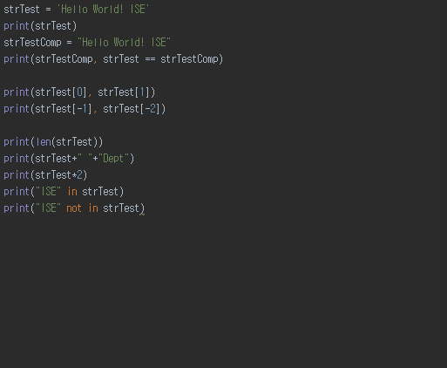
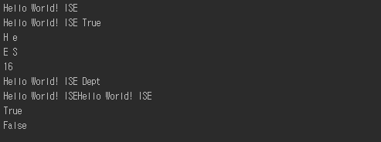
String
H | e | l | l | o |  | W | o | r | l | d | ! |  | I | S | E
0 | 1 | 2 | 3 | 4 | 5 | 6 | 7 | 8 | 9 | 10 | 11 | 12 | 13 | 14 | 15
 | -15 | -14 | -13 | -12 | -11 | -10 | -9 | -8 | -7 | -6 | -5 | -4 | -3 | -2 | -1
String variable statements
Both of ‘ and “ work as wrappers
String value equivalence test, quite simple!
See how the string operators work!
String variable is actually a linear collection of letters, and the letters have indexes
Existence check in collection variables

Slide 14
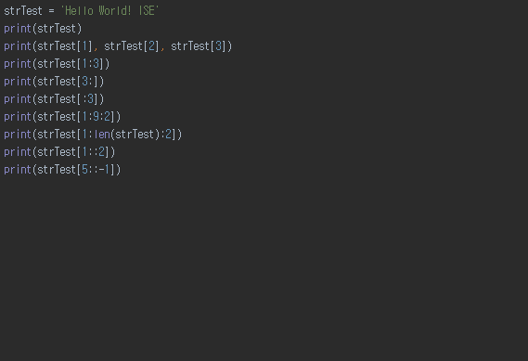
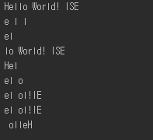
Index in Sequence
This index applies to strings
as well as tuples, lists
→ Applies to any sequence variables
Simple index of a sequence, or an array
x:y → from x to y
x:y:z → from x to y with z steps
Default:
y = the length of the sequence
z = 1

Slide 15
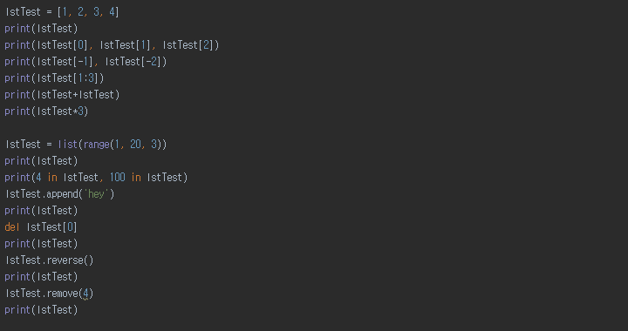

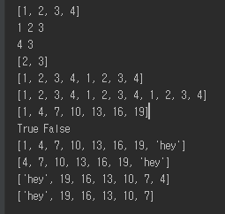
List
List is another type of sequence variables
See how the operators work
range(x,y,z) == x:y:z
You will use this function many, many times
in and not in comes pretty handy

Slide 16
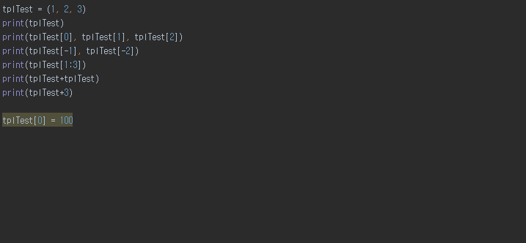
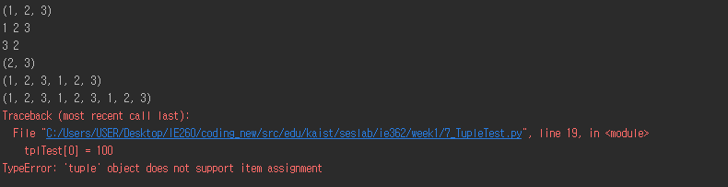
Tuple
Tuple and List are almost alike
Only different in changing values
Tuple does not allow value changes

Slide 17
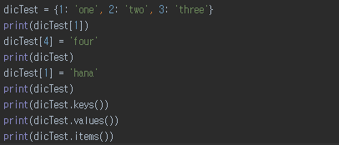
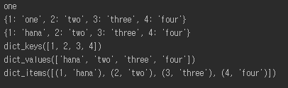
Dictionary
Dictionary is also a collection variable type
However, it is not sequential
It works by a pair of keys and values
A set of (key 1, value 1), (key 2, value 2), (key 3, value 3)…
Exact syntax is { key1:value1, key2:value2, key3:value3 …)

Slide 18
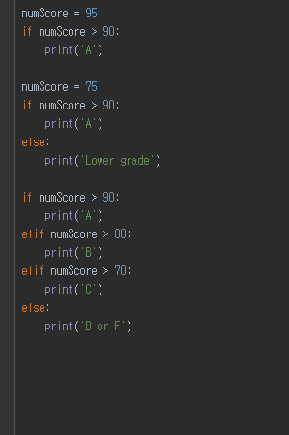

if
A condition statement
if boolean:
Statements for True
elif boolean:
Statements for True
else:
Statements for False
Python does not have a switch-case statement
You will have to live with ifs
Watch your indentations carefully because that is your block statements

Slide 19
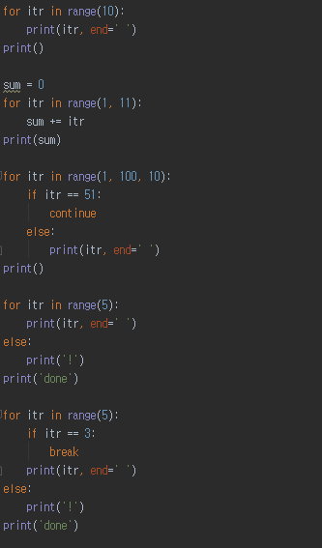

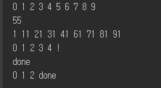
for
A loop statement
The most common loop statement in programming languages
for variable in sequence:
Statements for loop
else:
when for-loop is finished without a break
Some useful statements for loops
continue
break

Slide 20
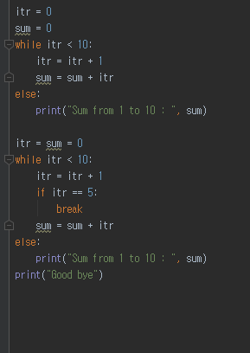

while
Second loop statement
Syntax is
while boolean:
Statements for loop
else:
when for-loop is finished without a break
Still you can use the two loop control statements
continue
break
Notes:
Last time, we’ve looked into what is a “for” loop.
Today, we are going to cover a "while” loop.
This is another type of loop statement.
Let’s see how it differs from the former—the “for” loop.
It takes a form of a “while” loop and a colon representing keyword and block. “while,” up to this point will make a single block.
If we are to formalize this form, we’ll do it like this.
The Boolean behind the “while” loop is a value representing either true or false.
The term “while” refers to the duration of something is kept on—it just continues unless interrupted. If the Boolean value is True, it will execute the relevant statement. If it turns out to be False, it will initiate an “else statement.”
A “while” loop has much in common with a “for” loop.
A “for” loop takes the following form.
You can also use an else statement.
When was “else” implemented?
It is executed when a “for” loop ends. When a forced termination command such as “break” is invoked, the else will not be executed and the program will skip the next block.
A “for” loop and a “while” loop are quite alike.
Basically, a “for” loop is controlled by using what’s on the list, whereas a “while” loop take conditions for control. Otherwise, they are all identical.
Therefore, it is possible to use the “break” and “continue” commands, which we’ve learned for a “for” loop, by applying them to a “while” loop.
When the “continue” command works, it goes back to the starting point of the loop.
Likewise, when there is a “continue” in the statement, it will return to the “while” loop. The part below would not proceed any further. Instead, whether it is true or false will be determined in the next Boolean statement.

Slide 21
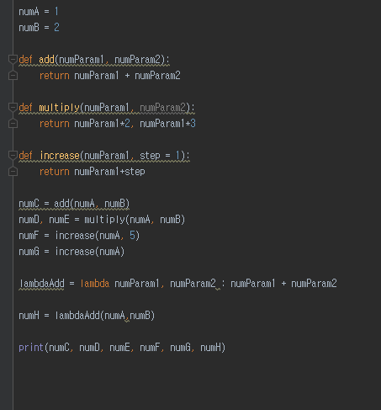
Function Statement
def name(params):
statements
return var1, var2...
You can return multiple variables
Keep them in order
You do not have to specify return types
Anyway you don’t have types in Python
One line function is called lambda function
Notes:
The previous “if” statement, “for” loop and “while” loop determine how they are executed under a certain condition in a program or how much they would operate or repeat iterations of blocks of code: in other words, they are used to control a program.
For various controls, we may use an “if” statement that appropriates conditions, and a “for” loop or a “while” loop that control iterations.
Beside controls, we also need content to actually run. That’s where a function statement comes in.
A function statement allows us to define functions.
For instance, the keyword called “definition” indicates and defines a function. Any name placed after that will become the name of the function.
A params will become the input of a function.
For instance, when we do y = f(x) in math, we’ve got to define f(x) first.
The f(x) here actually means ax + b, and a and b should be defined beforehand.
Here, x should be received whenever f(x) is calculated.
The x in this case is an input parameter.
Also, we need a range of statements, such as x is multiplied by a and added up with b, etc.
Then the calculated value should yield the output of f(x).
Now, “return” declares the value to become the output.
In the Python language, there is no such thing like “return type”.
There are other languages that require you to pre-write the characteristics of the output value of f(x) = ax +b: whether that type be float, integer, or string.
This isn’t the case for Python. The calculated value will result in an undetermined, count of return variable, regardless of its form or number.
Another characteristic of Python is that can return multiple number of values in undetermined forms.
It allows the return of multiple variables.
However, we should consider receiving variables from other places.
On the contrary, the following is possible.
In y1, y2 = f(x), we can input the values 3 and 4 in consecutive order.
However, we cannot assign 4 to y1 and 3 to y2.
So, when you return multiple numbers of values, you have to do the return in the correct order.
Here is an example that illustrates that.
As you see here, a function called “multiply” has been defined.
There are 2 input parameters and a colon to show that it is a block statement.
That makes it a single block, up to the return.
It multiplies 2 with numParam1 and 3 with numParam2 to make it a multiple return. It’s then divided by a comma (,).
Now, what would happen to the receiving part?
The result from numParam1 multiplied by 2 will be the first value. The second value turns out to be this value in that exact order.
Thus, it is necessary to carry out the return by strictly abiding by the correct order.
As explained before, there is no need to specify a return type.
This feature has its own pros and cons.
The advantage is that we don’t need to worry about which return type needs to be employed. We don’t need to consider which type best fits the situation.
This enables us to write return type according to certain rules. In this way, it’s more convenient.
In other languages, it is required to define a function as “double,” define the value of x as “double,” and then write “return x+3”.
What matters here is that as we know the input value is double. It defines “return the value that adds 3 to double x.” This value has decimal places, and it is impossible to operate this function if x is a string in this structure.
Therefore, we can check for any errors before calculating in the process of creating a program.
If we define x = “123”, we know that x is not an integer but a string. This prevents an error from occurring.
As functions and parameters do not have any type declaration in this case, however, the type of variables will be determined by the values they contain.
In other words, while this feature is convenient in writing programs, it also makes it more vulnerable to errors in operation.
In this case, it makes it a bit more difficult to design programs.
In the Python language, creating programs is easier, but it is more difficult to detect possible errors in advance.
Python has no type declaration. Instead, a variable’s type is determined by its value.
Python has a special function.
This function isn’t widely used, but it’s enough to know that it exists.
This is called the one-line function: it creates a function in a single line.
Even if a function is simple, it usually requires at least two lines: one for declaration another for its actual content.
This is a lambda function, and it can be fully completed in a single line.
The lambda function gets two inputs, and it returns the value behind with a colon.
This function, lambda add, works to receive and calculate the sum of two numbers before returning the result.
If we apply it like this, numA and numB is added to be numH.
In this way, we can simplify the definition of functions with the keyword—lambda.
When we are engaged in general purpose programming, we don’t need to use these kinds of function very often.
Yet, it is difficult to write down the dynamics for code every time in the field of science or engineering. Using the lambda simplifies things in this regard, so it’s good to know.

Slide 22
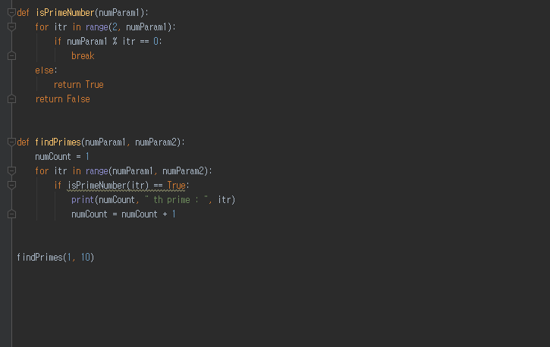
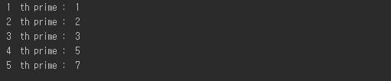
Sample Program: Finding Prime Numbers
Function for calculation
Function for
iteration
Triggers the execution
Statement for execution
Notes:
So, now let’s move on to analyzing one example program together.
As using definition and control for functions are possible, it’s a good idea for us to review an example.
Suppose that there is a program like this.
The program is classified by different levels.
Mostly, Python recognizes different blocks by indentation. Here, you can see that this example is divided into 3 blocks.
The 1st block is the definition, and the 2nd block is also a definition.
You can see that the 1st block is designed for defining functions.
The same goes for the 2nd block.
The 3rd definition is not a function definition. It’s the part that calls actual functions.
In other words, this is the part where the actual program is run.
The definition clarifies the meaning, while the calls actually perform the work.
The 3rd block executes a function called “findPrimes”.
findPrimes is not an inner function stored in Python.
It is defined in the 2nd block.
Then, it will call findPrime.
If a call occurs here, it will move on to this side.
Value 1 will be input to numParam1 and 10 to numParam2, respectively.
After completing the definition, the program will begin from this point on. The program will then call the function to move on to the definition just.
From here, it will execute the part below by assigning 1 and 10.
It will create “numCount = 1”.
There is a “for” loop, and something called a “range”.
numParam1 has a value of 1 whereas numParam2 has the value of 10.
In the range (x, y), when x and y get the values of 1 and 10, this range signifies that it is over 1 and less than 10.
Thus, it will produce the outcome—1, 2, 3, 4, 5, 6, 7, 8, 9—in the form of a list.
This is the output of the range.
The values within will be assigned to “itr” in order.
And the keyword, “for”, will get the loop going.
At the very beginning, the value 1 will be assigned to itr.
This is a statement that states assumption that if it is True or False, it is identical or different.
isPrimeNumber(1) is calling another function.
If you try to search it in google, you cannot find isPrimeNumber in a list of the built-in functions of Python.
As isPrimeNumber is declared above, it will go to the 1st block when a function calls for it.
This part serves to place the value of 1 into numParam1.
This is basically who this function, isPrimeNumber, works.
Next, a “for” itr in range(2, numParam1) program will be executed.
Originally, it is supposed to be a range(2,1). Nevertheless, the loop will stop because there is nothing corresponding to itr in the absence of the list over 2 and under 1.
With the loop finished, it will reach for the keyword “return” through the else statement and hand over the return of True. Thus, it will descend to the lower part from the if statement.
The value 1 will be applied to numCount, the print result for numCount, which is “the prime :“ as well as itr. It eventually prints out the result below.
And then, one more numCount will be added once again to make 2.
After executing these commands thus far, it will ascend up to this point by the “for” loop.
Next is the itr’s change into 2, which is next to 1.
When the itr becomes 2 due to the input of the above function, it will return True because there is no list under 2. Since True and True are the same, both the numCount and the itr will get the numeric value of 2. Consequently, these results will then be printed out.
Lastly, the itr gets the value of 3, and a numParam1 will be assigned with 3 in the isPrimeNumber function.
As the list represents values above 2 and below 3, numParam1 will get 3 and the operator % will calculate the rest. The remainder 1 of 3 divided by 2 is not equivalent to 0.
As they do not match, it would not descend but go back to the “for” loop. Since there are no more elements available, it will return True via the else statement.
Then again, 3 will be printed out like this.
After that, the value of the itr turns into 4, calling isPrimeNumber(4).
The range produces the list containing 2 and 3. As the remainder of 4 divided by 2 is 0, it will use a break to return False without going through the else block.
As True and False do not match, the lower part will not be executed, and then the program jumps to 5.
Thus, it will not print out 4 here.
So far, we’ve examined an example program.
The program we’ve created was one that searches for decimals that are not to be divided, saving 1 and the numbers themselves.
For the program, we’ve applied function definitions, various operators, a “for” loop, and “it” statement.
This kind of programming enables us to solve a problem by using basic math knowledge.

Slide 23
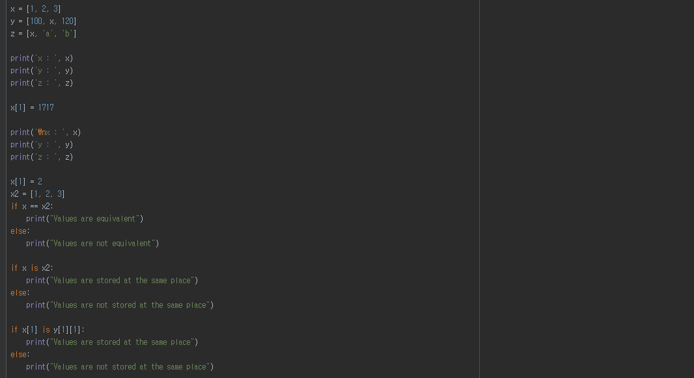
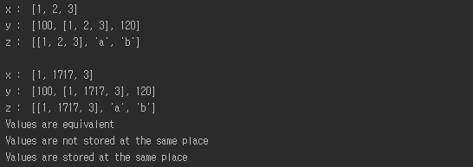
Assignment and Equivalence
y
1
x
3
reference
x
1
2
3
reference
One variable’s value is changed
But, you see three changes
Why this happened?
Because of references
x has two references from y and z
The values of y and z are determined by x, and x is changed
See the ripple effects
==
Checks the equivalence of two referenced values
is
Checks the equivalence of two referenced objects’ IDs
z
x
a
b
Notes:
Now, let’s move on to the topics of Assignment and Equivalence.
The values will assign variables, and we’re going to check whether the value stored in these variables are identical.
Back then, it was very easy to compare value to value. Nonetheless, it gets more complicated when we compare lists or objects to be handled later.
Even experienced programmers make mistakes dealing with this issue.
As a result, it is crucial to get a knack for the underpinning mechanisms.
Let’s look at the following example.
When we choose x in which to store the list of [1, 2, 3] and then print it out, we will get [1, 2, 3].
However, let’s consider the case of y = [100, x, 200].
Here, x is not a numeric value such as 5, 10, and 1000, but a list, [1, 2, 3].
What would happen if we insert a list into another one?
In conclusion, the list, [1, 2, 3] will be assigned as it is.
100 will be assigned as an element of y, and the list of [1, 2, 3] for x will be inserted in-between commas (,). Therefore, it appears to act as an element, and the list inside the list will be filled in before finally receiving 120.
Here, we have a list, z, and it’s represented as follows.
x will be included as a part of list in the form of another list. a and b will be brought out to a string.
The very occasion when a list is inside another list is called “nested”.
Just like a bird nest can be set in another nest, a list can be put inside another one. We call that a “nested list”.
We now understand that a list can be an element.
Now I’m going to change x’s element to 1717.
In Python, as an index starts from 0, the values of the previous x was 1, 2, 3 but now the 2nd value, 2, is converted to 1717.
As the element value of x has been modified, it will print out [1, 1717, 3].
Any change in x, however, will affect y and z.
Though we did not modify y, there is a list of 1717 in the place of x.
The element of z has been also changed to 1717.
It means that the change in x caused changes in y and z.
Why does that happen, then?
We’ve got to think about how a computer memorizes x, y, and z.
As you see here, x stored 1, 2, 3 in the memory with an index.
Within y, the second value in [1, 2, 3], is not actually in the list. The second value is more like an arrow that points at x.
In other words, a computer does not copy the values of x in y but the location information on where to obtain x,
The arrow I’m talking about here is called a reference.
Likewise, z has x, a, b. In the place of x, there is the location information of where x is stored, along with the strings a and b.
In the place of x in z, there is x with an arrow that indicates the venue.
Therefore, while the precedent x stores [1, 2, 3], it will print out [1, [1, 1717, 3], 3]. Since 2 was changed to 1717, it will indicate [1, 1717, 3] instead of [1, 2, 3].
As z receives the value of x, it will get [1, 1717, 3], rather than [1, 2, 3] due to the modification of x’s value.
In regard to storing values, you should note that in some cases, the original [1, 2, 3] or [1, 1717, 3] is stored. It also comes with a bar called a reference, which tells the program where to fetch a value.
When assigning some values or variables, there are two different cases: the program can bring the exact values themselves, or it can fetch values as directed by the list.
Normally, the values of a string or scalar are stored as they are.
Just like int or double that we’ve covered earlier, these primitive variables are stored without modifications.
But lists or various objects are usually stored in the form of a reference.
Here, as x takes the form of a list, it is stored as a reference.
Some of them compare values or references, referring to identical ones.
Thus, there are two ways to compare equivalence.
One is “equivalence” and the other is called “is”.
When x[1] is again converted to 2, x becomes [1, 2, 3].
Here x2 = [1, 2, 3] is assigned.
In this case, you can see that equivalence is compared.
When x and x2 is compared against ==, it assesses if the referenced values are the same.
This asks the question: are x and x2 identical?
You will find that x here is specified as 1, 2, 3 while it is stored 1, 2, 3 in x2 in another place.
The question asking if x and x2 contain identical values is used here to figure out their equivalence.
The answer to the question is: yes, they’re identical.
They are the same and the condition becomes True, consequently printing out that the values are equivalent.
The purpose of the question is to uncover if x is x2, or the lists called x and x2 are identical variables, or their reference are the same in the perspective of a storage place.
As x and x2 are stored separately, their values are the same, but not their reference.
So the condition turns to False, printing out: The values are not stored in the same place
Now let me pose a more in-depth question to you.
The 1st element of x includes 2.
In this context, it is asking if x[1] and y[1][1] share an identical reference.
As for y[1][1], the 1st index of y is x and indicates the 1st index of x, or 2.
The two are pointing to the identical location, so the condition is true.
The 1st element of x and y are directing to the same location, so it will print out: The values are stored in the same place.
Thus far, we’ve seen how a reference would give rise to these events.
While == compares what’s actually stored in two references, “is” is comparing whether or not they are referencing the same place.

Slide 24
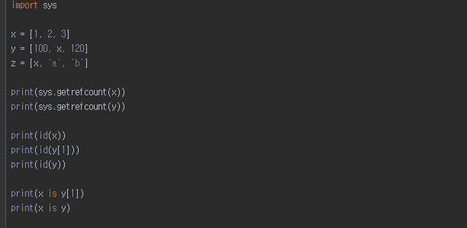
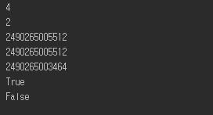
References, Symbol Table, and Object Table
ID(variable) returns the referenced object ID
ID(variable1)==ID(variable2)
→ variabl1 is variable2
sys.getrefcount(variable) returns the number of references of an object ID + 1
Symbol Table
Var. | x | y | z
ID | 38872808 | … | … | … | … | … | … | … | 38873048 | …
Value | List object named x | 1 | 2 | 3 | 100 | 120 | ‘a’ | ‘b’ | List object named y | List object named z
Object Table

Slide 25






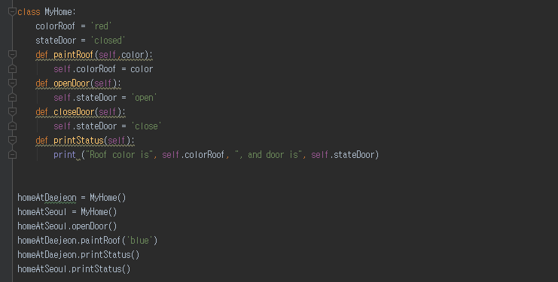


Class and Instance
instantiation
See how to define a class → class classname:
See how to instantiate a class → var = classname(param)
Notes:
When we discussed about “equivalence” and “assign” before, we’ve dealt with data types that do not belong to primitive types such as double, int, and string.
Lists and dictionaries are examples that do not fall into the category of primitive data type.
I also explained to you that there are some objects that you can create. I’ll show you how you can do that.
First, you’ve got to understand what is a “class”.
As mentioned before, there are some blueprints that serve to build houses, or instances, using instantiation.
In this regard, a class plays the role of a blueprint, while an instance assumes the role of a house.
I’ve defined a class that I’m calling “MyHome”.
MyHome is composed of blocks, which contain function definitions made up of variables and def.
In other words, it shows that there are several functions and variables within it.
Here you will find 2 variables and 4 functions.
The name of the class is MyHome.
The part up to here makes a single block and is declared as a class definition.
The definition does not make any action. It’s here to make a definition in advance.
The actual work or actions of the program are done by what we call a “function call”. You call functions to execute them.
As you see here, two brackets are applied to execute MyHome(), just like a function call.
You will learn about this later. This is a function call that brings about a constructor for building a house, or in this case, an instance.
The “return” of the function constructor marks that an instance has been generated by the constructor.
The variable contains the instanced class, MyHome.
As for a homeAtSeoul, there will be a different instance inside it.
What if a homeAtDaejeon is homeAtSeoul?
It will draw a comparison between references.
We’ve learned that it is stored as a reference if it is not a primitive type.
The same logic applies when storing it as a reference.
As this and that are different instances, their storage places will vary.
Therefore, the condition is false.
Let me direct your attention to homeAtSeoul.openDoor().
Here, the period (.) serves to call the variable or function of an instance. In this case, the function openDoor will be called.
Seoul calls a function titled openDoor while Daejeon calls a different function, paintRoof.
As clarified before, this function would normally receive an instance and color as input. Nevertheless, it will only get color here.
The self refers to homeAtDaejon, or instance. In this case, the targeted instance is itself.
This is a function that directs the change of colorRoof into the color in homeAtDaejon.
What’s originally red will now turn blue.
The colorRoof of homeAtDaejon remains red.
This line will call the function named printStatus from homeAtDaejeon.
This function calls the printStatus from the instance of homeAtDaejeon to print out blue, which is its colorRoof.
Although the colorRoof stored in homeAtSeoul is still red, as we’ve designated the colorRoof of homeAtDaejeon as blue, it becomes blue.
So the roof color is blue and the door is closed. We haven’t done anything to the door, so it will print out ‘closed’.
However, if we execute printStatus in homeAtSeoul, it initially becomes the original roof color, red. It will print out that the roof color is red, and door is open when the openDoor function called.
Now, we’ve defined classes and created instances, just by like imprinting them one by one.
We’ve created two houses or instances with a single class.
With “for” loops, it’s no sweat to make more of them.
Each house has its own variables that represent functions and characteristics.
The following is the definition that presumes that these houses are instances and their blueprints are classes.

Slide 26
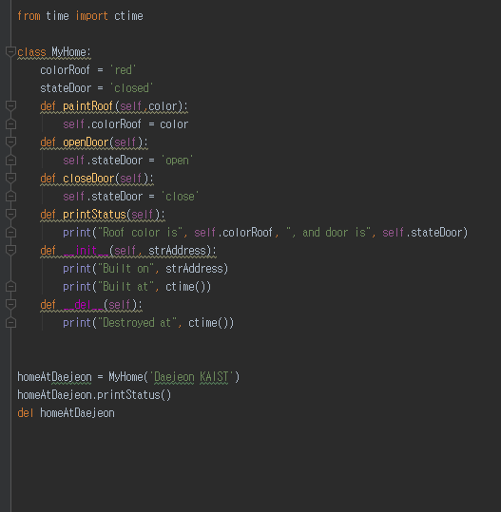

Important Methods in Class - Constructor, Destructor
Some basic methods, or member functions in classes
Constructor
Called when instantiated
Deconstructor
Called when the instance is removed from the value table
Notes:
The aforementioned class is also involved in several important methods.
The most important of all is a constructor.
And there is a destructor, but it’s not widely used.
The class MyHome that we’ve defined before has some variables and functions.
This has 2 variables and 6 functions.
This is generally referred to as six-member functions. Now, let’s examine these newly introduced functions.
One starts with two underscores (_) with another two underscores after init.
It is a common rule to name this specific type of member function as a constructor.
A constructor is a function that is called during an instantiation operation.
There is a blueprint called class, and the constructor is called at the point of time when instances are generated.
In terms of code, the block is divided like this. This part represents a class definition.
This part is what’s actually executed.
The part written as MyHome(‘Daejoen KAIST’) is instantiated by means of an “init” function in a MyHome class.
The previous code did not have anything within the brackets, but now it has an input, “Daejoen KAIST”.
The difference is made by the presence of strAddress, the input parameter of the constructor or __init__.
Here, there is no self in the constructor.
It will denote an instance itself that will be generated by the call of the function or constructor.
It is not yet present. What will be returned will become a self.
This is a typical situation generated by the constructor, __init__.
strAddress here will make use of function called ctime to print the current time and print the output as shown below.
As seen before, the member function, .printStatus, will be used to print the roof color and the status of the door.
When they are all consumed to eliminate MyHome, a del is inserted to call homeAtDaejeon.
This process eliminates the instance called homeAtDaejoen generated by MyHome.
This is the opposite of the concept of a constructor, and it is called a destructor.
A destructor takes the form of __del__.
It only has a self without leaving anything behind.
The command will print out when something is to be destroyed or deleted.
This is a function that is called to eliminate or delete an instance.
It is possible to initialize a constructor by putting a specific parameter during its generation.
The __init__ will be called when a house is built. For any instance that will be made, it is imperative to designate a roof color.
The constructor is a great function to call for initializing an instance or for starting a program with pre-determined desired values.
We need a deconstructor when we tinker with files in a class or handle a means to communicate.
When an instance abruptly vanishes in a situation where a file is dealt by multiple instances, other relevant instances would get confused.
Hence, the deconstructor allows us to insert some text to properly arrange the self.
Although it is not commonly used, it is essential for experts to use deconstructors to ensure the safe and stable operation of programs.

Slide 27
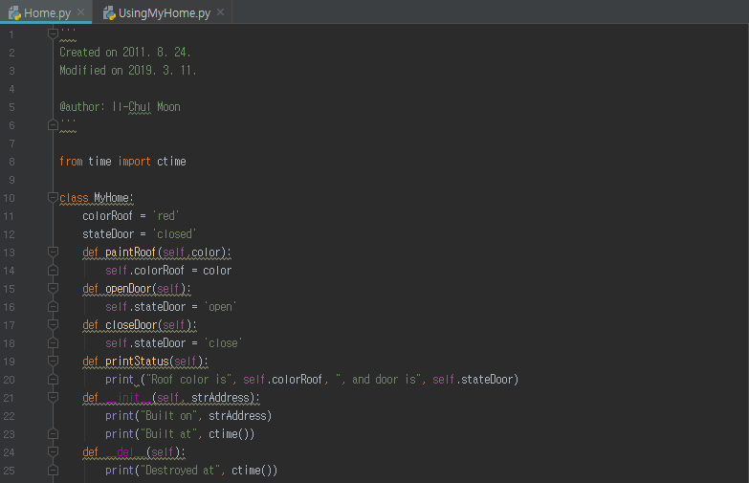

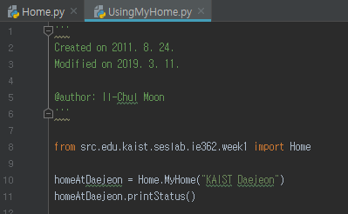

Module and Import
See how to separate the source code files
Just put your code in another file
filename.py
See how to use classes in other files
import filename
Use from to specify the directory, or the folder, path
Notes:
So far, we’ve explored how a class is constructed and how to carry out programming from the previous slides.
Today, we will examine the ways to utilize a class that is copied multiple times.
Once you create a program, you need to develop and re-utilize it further.
As you do so, you will find yourself with long blocks of code for programs.
It is not easy to crunch dozens of classes into a file.
I would rather recommend that you put one class in one file.
For today’s lecture, we’re going to observe how we could use a multiple number of classes together.
First off, let’s look at the code.
Take a look at what’s inside this python file titled home.
You see all sorts of comments, from this to that part.
What’s below includes from time import “ctime”.
Here, “time” refers to a package.
Let’s say that a wrapped gift is called a package.
Then, we are bringing ctime within the package that can control ‘time’.
That’s the way we make the use of what we’ve brought in.
The syntax for using “ctime” is below.
As you see here, there is a class called MyHome.
The class here is a keyword to represent its property as a class while MyHome is the name of the class.
We put a colon (:) to indicate that it is a block, eventually showing that it is a single class.
Then, colorRoof and stateDoor are the member variables of this class.
A member variable is a variable that belongs to a class.
Thus, it can be viewed to store the status of a class.
What’s next are the four general member functions.
Each member function consists of a block.
They also include two special functions.
One is called a constructor, and the other is called a destructor.
It shows that “ctime” is used within the constructor.
The ctime’s brackets indicates that it plays the role of the constructor of a class called ctime.
This is how ctime is implemented in this case.
In short, somewhere there is pre-devised code called ctime inside a package called time. This in turn allows us to issue a command to find the package to fetch "ctime to use it.
Now let’s apply the class MyHome elsewhere.
I’ve created another file, UsingMyHome.
MyHome has two different files titled Home.py and UsingMyHome.py/
In another file, I wrote down “import home”.
Now, if you run a program, you will see it operates without any errors in running “import Home”.
This means that Import Home actually fetches the Home.py file.
Here, we also find ctime.py, which again includes ctime.
One way of look at it is that import Home retrieves the Home.py file to executive in advance.
When it runs “import home”, all of that file’s content will be summoned and executed here.
That way, we can run the Home.py at the very moment when Import Home is done.
All the content in Home.py is delivered here. That includes the class MyHome.
Then, it is created by the process of import. Now we can perform, “home.MyHome”.
Let’s suppose that we are executing Home.MyHome.
This means that we’re going to employ the MyHome class within a python file, Home.
When we import a python file, we write down the file name, home, too.
This will call a constructor to MyHome.
The constructor of MyHome will receive a string, strAddress, creating an instance.
After that, it will summon a function named printStatus.
When the program ends, it will call the destructor.
These two sentences fall into the realm of a constructor, while the 3rd sentence is made by printStatus.
The last one sentence is produced by the destructor.
First off, we could use Filename.py to make a file like home.py in a different place. Then, we can just import the file.
Besides, what if there are many files to deal with? Do we have to put them in a single folder?
We can define the path with the directory or folder where files are called. We designate this path by using “from”.
In other words, we can write down a directory to define a package.

Slide 28
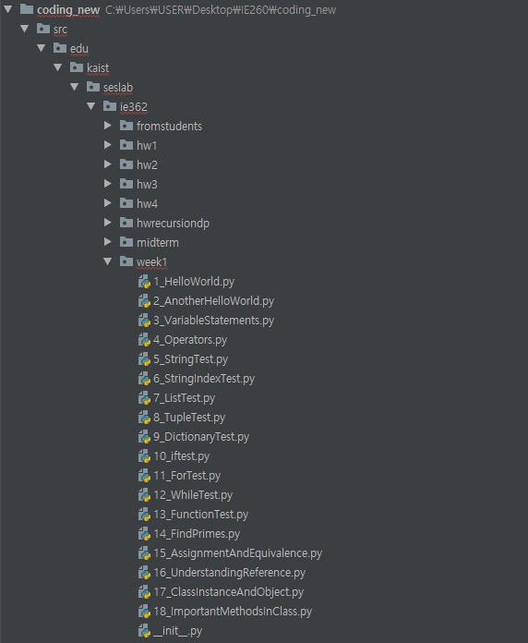
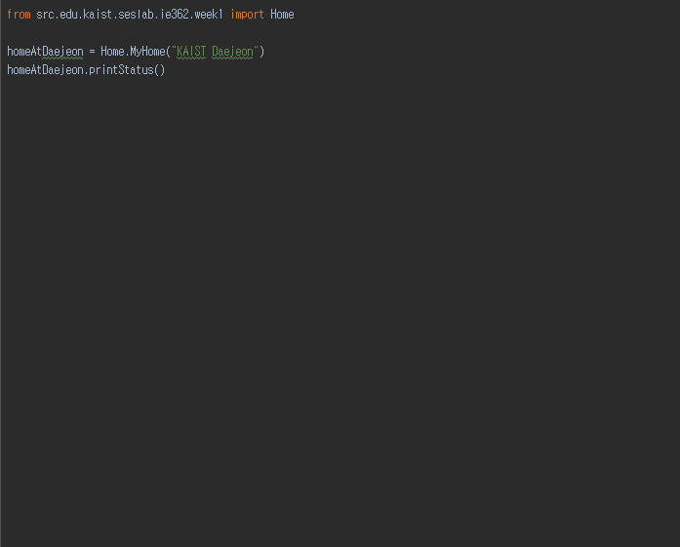
Organizing Modules by Package
Directory, or folder
Clusters modules
Modules → filename.py
We call these directories as package
Hence, the previous information is exactly
from package import module
Package has
__init__.py in the directory
This is how to differentiate between the ordinary and the package directories
Notes:
Now, let’s find out the way to define a path for importing a file from its directory.
This is done by using a development environment called pydev.
Using pydev helps us to set up a source code directory. We do this by indicating the configuration of the pydev development environment.
Here you see that it defines where the source code is.
Below, it illustrates the directory structure of the defined source code.
Edu, kaist, seslab, ie362, week4 refer to the directory structure.
The directory or folder structure points out that the week1 folder is in the ie362 in the seslab folder, which is in the kaist folder inside the edu folder.
Here you will find __init__.py.
This refers to a file that shows that this specific directory is indeed a Python package.
What’s below here are actually python files within the week1 directory.
Just like the previous home.py, this python folder keeps files that we’ve defined.
When a directory is set as it is, we import a specific file such as a home.py inside. Let’s take a look at how we do that. If you look at this, you can see “from edu.kaist.seslab.ie362.week1.”
The directory structure is written after the word, “from”.
As for import, you may just add a file extension to the name, Home, that we’ve seen before in front of the import.
One of the advantages of using directories or folders is that we can collect multiple modules like filename.py.
When a sizable number of modules are gathered together, it is called a package.
Though it is written after “import”, which actually omits the word, “from”.
When we use a module in the same directory, we can just skip it.
As we do not always use the ones in the same directory, however, we can just write the file’s directory from the location in which Python is executed. We can then write the name of the file after “import”.
And now we are going to organize a module using the directory structure.

Slide 29
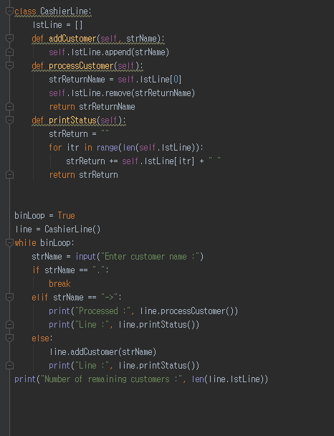
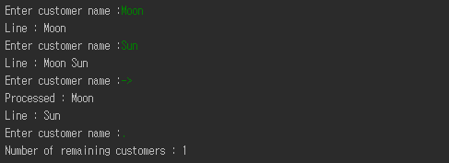
Sample Program: Interaction with Your Program
Member variable
See how to define a member function
def funcname(self, param):
Iterating the member variable to print out who are in the line
Add self when accessing member variables
Your first interaction with a python program in this course
Notes:
So far, we’ve learned how to define a class and its application.
As for the last part for this week, let’s take a look at the code as we try to comprehend the overall program.
Let me cite a class definition first.
As there is no import, we don’t receive it from outside.
From here to there, we have a class definition block.
The name of this class is CashierLine.
It is a member variable in the form of a list, and it can store many elements.
Also, there are member functions such as addCustomer, processCustomer, and printStatus.
It is in a state that has a definition only. In this case, no other execution will occur in Python.
The part to be executed will have a value of either True or False in a binLoop variable.
The following is a simple sentence that puts a specific value into a variable.
The sentence, line = CashierLine() will be the constructor of CashierLine.
The constructor will create one instance in accordance of the definition, CashierLine.
It will generate an instance of CashierLine to store a specific variable, line.
Below, you will see a while loop.
There is a loop, and it will be executed while the binLoop is true. Since the binLoop is set to True, it will just keep on running.
A raw_input is a command that can be called by receiving keyboard input.
When keyboard inputs are entered, it will be stored in a string format in strName.
If the entered string gets a period (.), it will break out of the loop. Since “while” has an else statement, it will jump to the else statement once it encounters a break. It will then execute what is shown below.
So, does it carry out line.addCustomer at the moment a period (.) is entered?
I’ve made a mistake with this part.
As Python distinguishes each block with indents, I made a mistake interpreting this part.
I intentionally showed you this video part without cutting it out.
After all, I also sometimes misinterpret Python scripts.
Let’s look into this in more detail.
The while loop spans from here to there, not to the else statement.
Then what does “else” overlap with?
This else is a part of an if – elif – else section.
Hence, when it encounters the break command, it will just escape from the while loop.
If the else is here below, it would run the else. As the else here overlaps with the if, the break will skip to the next part.
That is to say, when a period (.) is entered, it will print out the number of remaining customers: 1.
When something other than a period (.) is entered, let’s say an arrow (->), what would happen?
It will call the function, processCustomer using the variable line.
You will see the function here.
As it is the first on the list (for it starts with 0), it will remove the name and return.
The 1st element is then removed and returned, and the person lined up first will be printed out and then disappear. Whoever is behind the 1st one will then replace the position of the 1st one.
The program will then print out the line and call the printStatus function, which will connect all the people in the line and print them out.
You can see it illustrated here. It shows that Moon is processed and that Sun is standing in line.
When neither an arrow or period is entered, but something else is input, it will apply an addCustomer function and print out the line.
This is how the program is constructed.
When the Moon and Sun are entered, or an arrow or period or input, it will print this result out, showing whoever is remaining in the line.
As such, we’ve defined classes and created some code that we can use.
The most important thing is to practice coding and get some hands-on experience.
If you don’t do so, you can’t expect to develop your programming skills.
Another thing to note is to follow the flows of programs to examine why they operate the ways that they do.
If you go over programs to discover how they operate, you’ll be able to make rapid progress in improving your programming skills.
This will conclude the first week’s lecture.

Slide 30
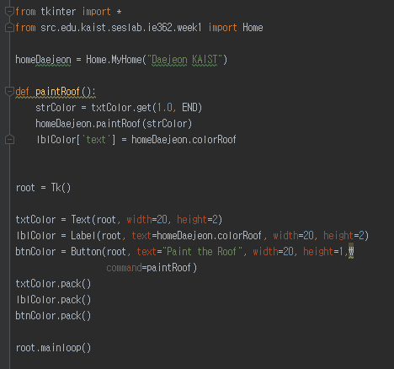
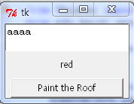
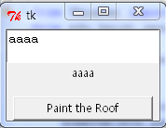
Sample Program: GUI in Python
There will be chances to cover more on GUI in the future of this course
GUI in Python
Need to import many modules from tkinter package
Statements
Instantiate and place your GUI items
Text
Label
Button
You can link a function to the items at the instantiation timing
“command=paintRoof”
pack()
Make the items to fit the specified size
root.mainloop()
For you to see the dialog window
Make the window hold

